Slide 1

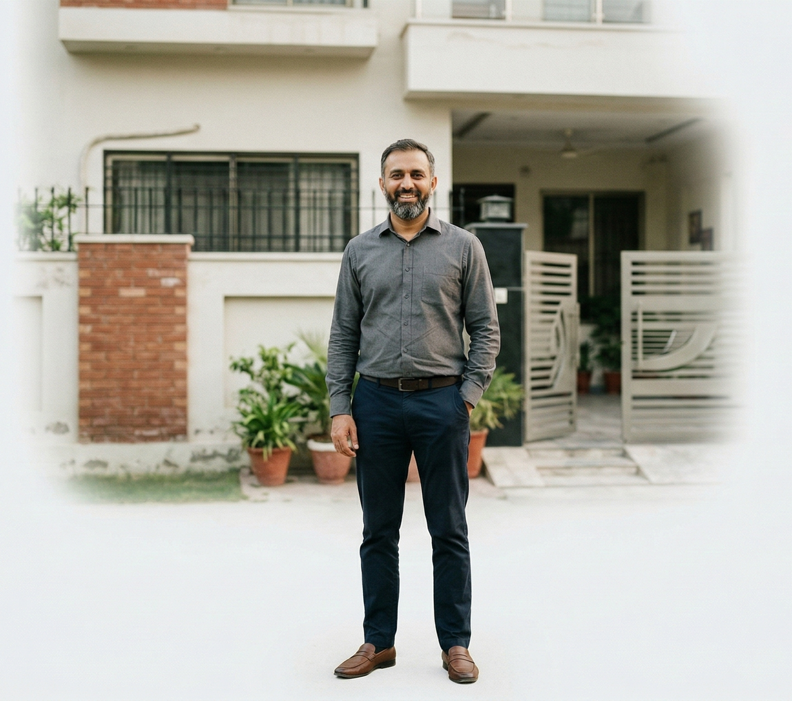






Salman -- Small Business Owner
Salman is a pragmatic researcher who values technical data over marketing hype. Deeply risk-averse, he acts as a "Family Sentinel," prioritizing his household's comfort during Lahore's peak heat.
Age: 39 | Lives in Lahore
Behavioral Mindset
Deeply concerned with family financial security, inflation defense, and preserving capital; carries a high fear of systemic scams or bank/agent dishonesty.
Family Status:
Married with children; lives in a multi-generational household.
Property Type: Self-owned 10 Marla house.
Top Interests and Affinity Index:
News & Politics / Avid News Readers – i135
Banking & Finance / Avid Investors – i137
Food & Dining / Foodies – i130
Life style/Hobbies -- i125
Vehicles / Auto Enthusiasts -- i120
Shoppers / Bargain Hunters – i115
Pain Points:
Maturity Return-Oriented: Evaluates savings strictly on guaranteed multiplier returns (e.g., expecting 3× to 4× payout over 15–20 years to combat inflation).
Direct Institutional Dealing: Prefers depositing premiums directly at physical head offices or via verified official bank counters to ensure receipts are genuine.
Family-First Legacy Savings: Willing to sacrifice current lifestyle liquidity to secure long-term funds specifically dedicated to children's higher education, weddings, or personal pension income.
Shariah-Compliance Sensitivity: Strong preference for Takaful savings over conventional insurance to ensure peace of mind regarding religious principles (Halal income).
Buying Triggers
Seasonal Shift: Increased load-shedding at the start of April/May. Referral Trust: A recommendation from a "Technical Friend" or a social media "Brutal Mentor" who shows a real-world stress test. Warranty Clarity: He will choose a brand that offers a clear, verifiable "Company Warranty" over a vague "Shop Guarantee."
Media Consumption
Traditional Meida: (65%), (46%), (5%)
Social media on his phone: (66%), (70%), (45%), (50%)

